Slide 1
bias in a.i.
Hal Daumé III | University of Maryland | me@hal3.name | @haldaume3

Slide 2
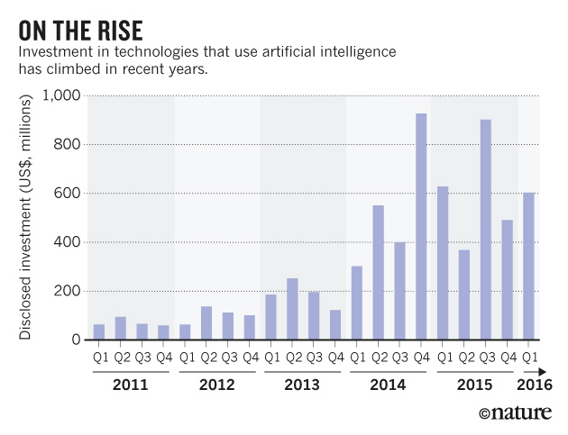
the age of automated decision making

Slide 3
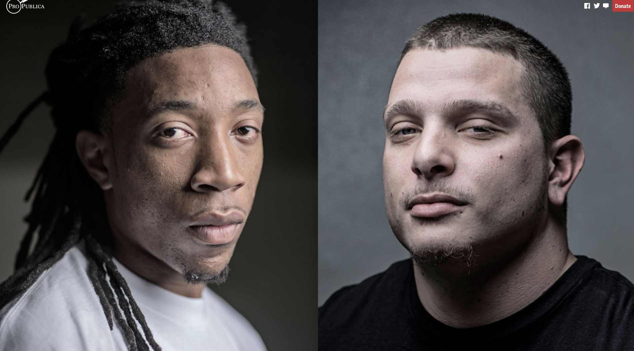
things can go really badly

Slide 4
three (out of many) sources of bias
data collection
objective function
feedback loops

Slide 5
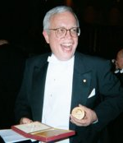
sample selection bias
true population
uh. oh.
population
samples
machine
learning
predictor
yay!
James Heckman, Nobel prize econ (2000) Sample selection bias as specification error. Econometrica (1979)
Corinna Cortes, Domain adaptation and sample bias correction theory and algorithm for regression
TCS, 2013

Slide 6
it's not just that error rate goes up...
train on electronics
rate of positive predictions
book
dvd
elec
kit
1.00
1.53
1.94
1.85
.468
book
book
1.17
1.00
1.55
1.43
dvd
.509
dvd
1.81
1.71
1.00
1.06
elec
.505
2.19
2.29
1.55
1.00
elec
kit
.564
kit

Slide 7
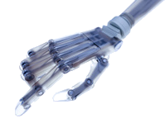
what are we optimizing for?

Slide 8
feedback loops in stop+frisk
Can we reduce the number of (and bias in) stops under a stop and frisk policy?
What happens if/when police officers start using this system?
Personalized risk assessments in the criminal justice system
Goel, Rao & Shroff; American Economic Review, 2016

Slide 9
three (out of many) sources of bias
data collection
objective function
feedback loops

Slide 10
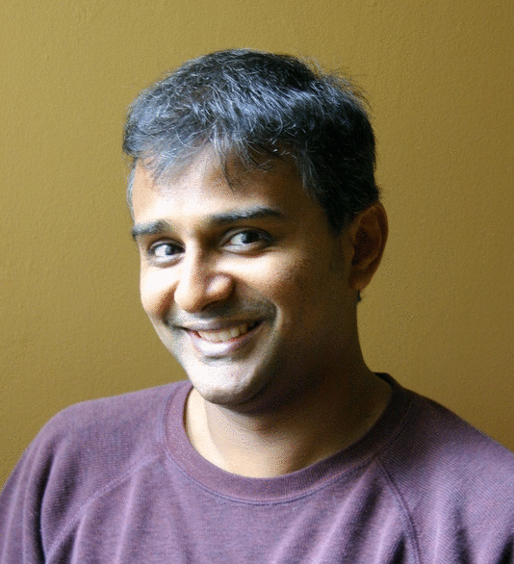
Joanna Bryson
@j2bryson
Kate Crawford
@katecrawford
Nick Diakopoulos
@ndiakopoulos
Sorelle Friedler
@kdphd
Fairness, Accountability & Transparency in ML fatml.org
Critical Algorithm Studies: A Reading List socialmediacollective.org/ reading-lists/ critical-algorithm-studies
Suresh Venkat
@geomblog
Hanna Wallach
@hannawallach

